Slide 1
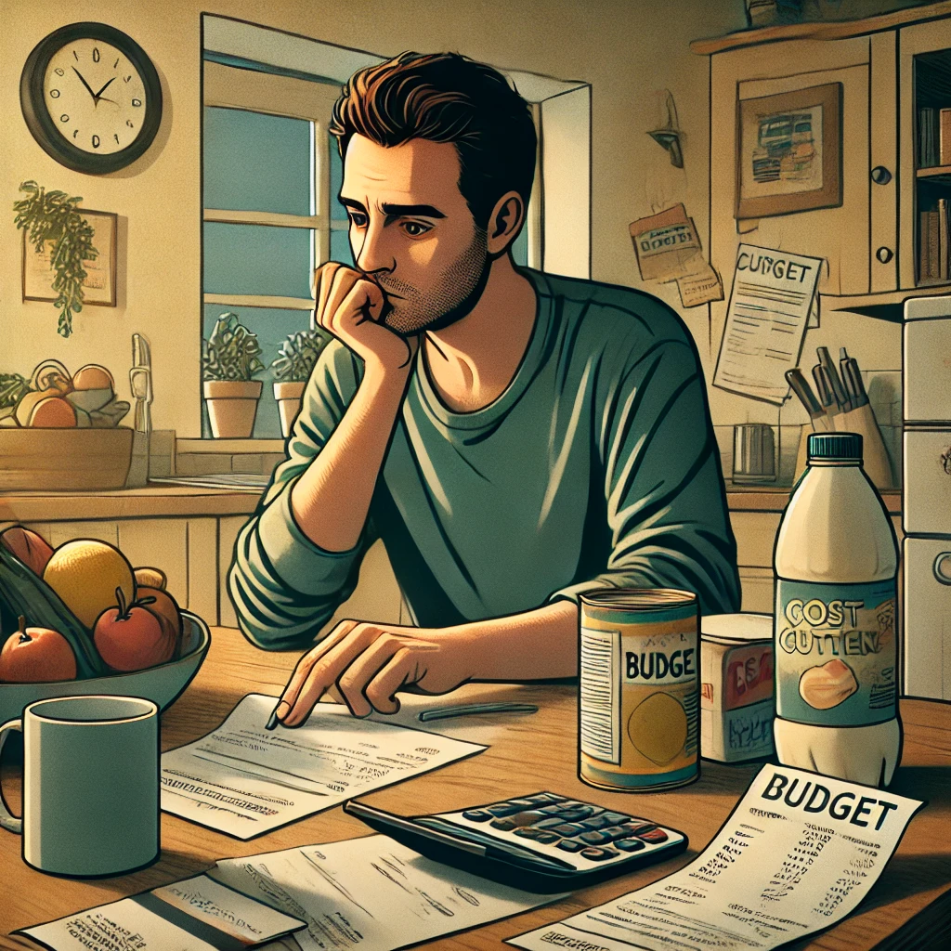
Consumption, job loss, and benefits
Seminar – Sep-2024

Slide 2
Motivation
XXX

Slide 3
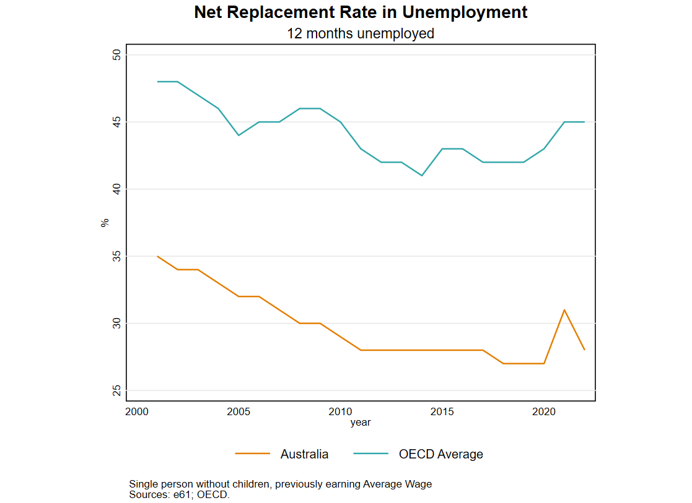
Insurance and optimal benefits
Permanent income hypothesis (PIH) – if job loss is a temporary income shock there
should be a limited change in consumption.
If individuals can perfectly insure against job loss risk, there should be no change in consumption from job loss.
Consumption changes can be used to understand more about the nature of job loss.
Evidence of government and family insurance against income shocks in general (Tin and Tran 2023).
Baily-Chetty result: Consumption response to job loss can be used to calculate the optimal benefit level (along with an estimate of labour supply responses).

Slide 4
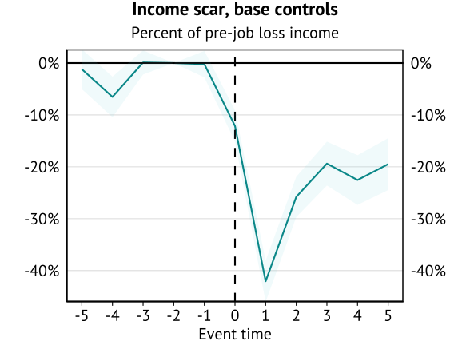
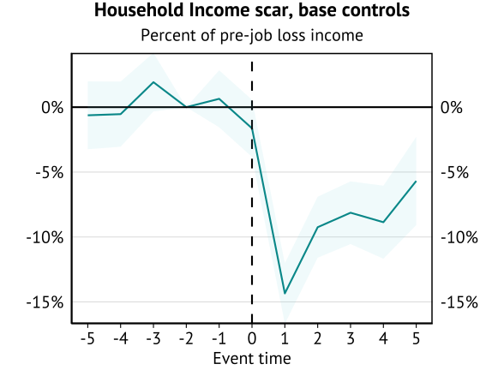
Recap: Income scarring from job loss
Individual wages and household incomes drop persistently following job loss.
Staggered Event Study (for consumption sample)
However, if this is a temporary drop in household income, we wouldn’t expect much of a change in consumption.
Implications for the “optimal” benefit level and coverage depend on how consumption will change.

Slide 5
Key lessons
General findings for Australia: Expenditure declines persistently – by about 10% - following the experience of job loss.
Other lessons
Elevated job loss expectations explain part of the decline.
Voluntarily displaced individuals, and individuals who don’t take up benefits, experience smaller declines.
Work related expenses appear to explain most of the initial decline in expenditure.
Early labour supply work
Limited intensive margin responses to benefit abatement (mirroring overseas results).
Some evidence of changes in speed of reemployment (extensive margin).
Match quality and the role of mutual obligations future areas of interest.

Slide 6
Measuring a consumption scar?

Slide 7

Why would expenditure change after job loss?
Lower lifetime income
Insufficient liquidity
Uncertainty
Lower expenses (work related costs)

Slide 8
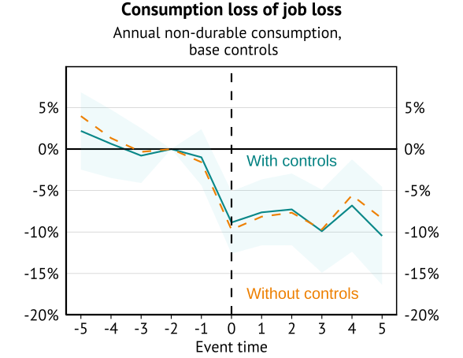
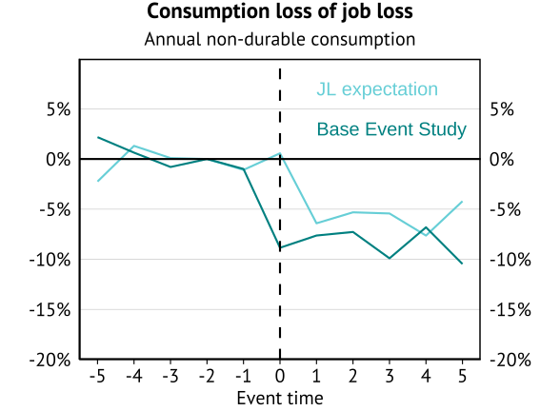
Consumption Scar
Scars controlling for personal characteristics and income. Additionally controlling for subjective job loss risk.
Future job-loss risk only explains a small amount of the decline in consumption.

Slide 9
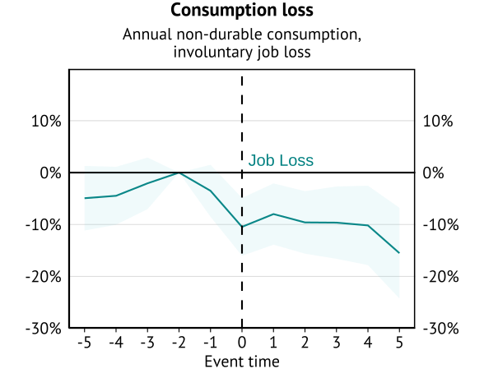
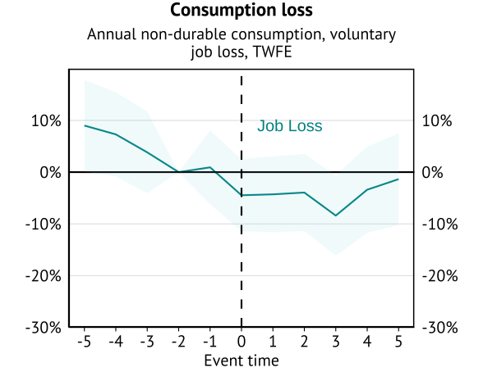
Type of unemployment scar
Involuntary job loss
Voluntary job loss

Slide 10
Beneficiary consumption scarring

Slide 11

Individuals, government, determine whether you receive income support
Job loss
Benefit application
Approval
Non-receipt
No application
Non-receipt
Our intention is to describe the selection involved in being approved or not approved.

Slide 12
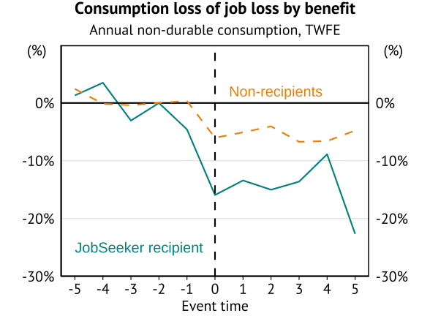
Benefit type
Would we expect benefit recipients to see a smaller or larger scar?
Receiving the payment reduces the liquidity constraint.
Subject of Clarke et al (2023).
Eligibility and take-up correlated with liquidity constraints (selection).
Much larger decline in consumption for those who receive income support.
Insufficient payment?
Insufficient coverage?
Heterogeneity.

Slide 13
Lessons from working from home

Slide 14
Why would expenditure change after job loss?
Lower lifetime income
Insufficient liquidity
Uncertainty
Lower expenses (work related costs)

Slide 15
Work related expenses
Why has consumption declined?
Tax deductions suggest work related expenses matter – don’t want to tax these expenses:
US standard deduction – 35% of average earnings, 23% of average FT earnings.
Australian tax-free threshold – 19% of average FT earnings (other deductions allowed).
So tax authorities say that “income” to pay for work related expenses aren’t income!
Without a job there is no need to pay work-related expenses. As a result, some of the expenditure decline is not a decline in consumption.

Slide 16
Work related expenses
We can’t just look at consumption decline on job loss.
Expenditure decline is BOTH due to lower consumption and lower work-related expenses.
Lessons from retirement.
Predictable exit from the labour market.
Hurst (2008) – expenditure decline is NOT a decline in consumption.
Combination of reduced work-related expenses and time to search for good deals.
What about lessons from working from home?
Suddenly working from home implies that some work-related expenses no longer occur (travel).
COVID as shock.
Will understate savings (time budget, cost of working from home).

Slide 17
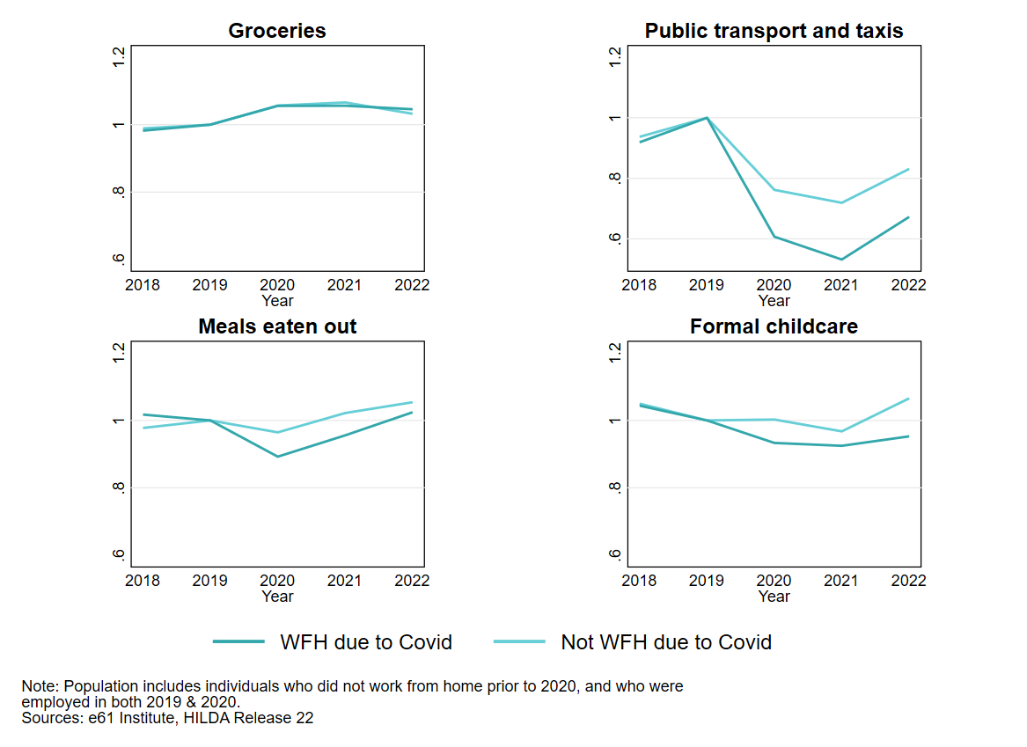
COVID Working from home
How much of the spending decline is due to no longer having to go to work?
Clear categories where spending did drop when working from home.

Slide 18
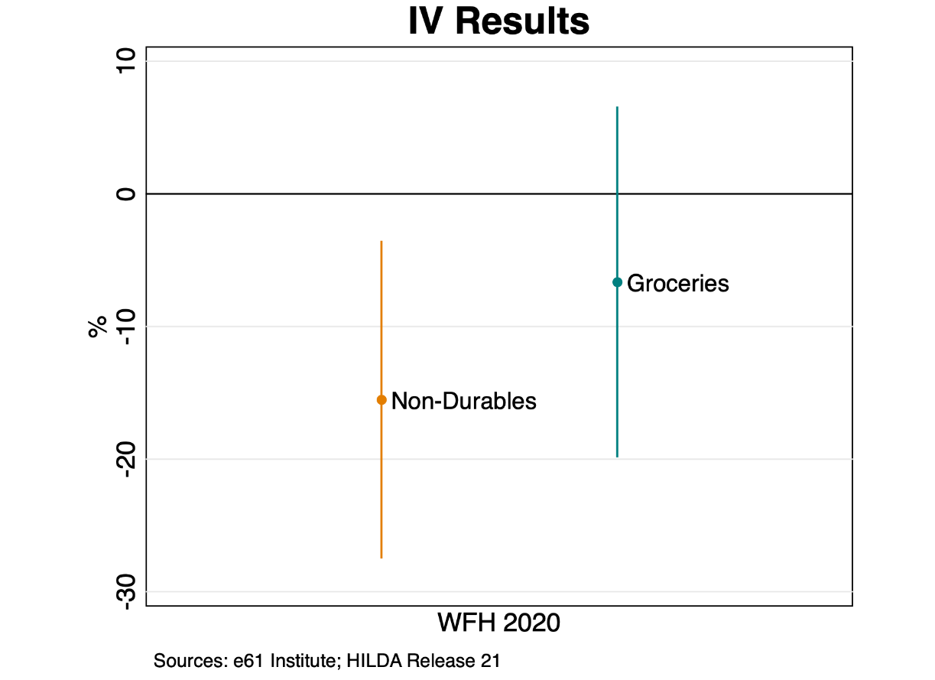
COVID Working from home (early work)
Aim for release late-2024 (in working paper)
Selection into Working From Home not Exogenous – IV approach
Use pre-COVID industry share as an instrument for working from home.
Initial estimate is a 15% decline in expenditure, however very imprecise.
OLS estimates are a 5% decline.
Grocery spending (which is seen as less work related) does not experience a statistically significant decline (6.6% reduction).
Scaling for time out of work, this explains 83% of the expenditure decline for non-beneficiaries.

Slide 19
Labour supply responses

Slide 20
Insurance and labour supply
How do benefits influence the incentive to work?
Baily-Chetty
Consumption responses after job loss reflect the potential “benefit” of a higher benefit rate.
However, total labour supply response is needed to reflect an important “cost” of higher benefits.
Work underway on labour supply
Intensive margin response to benefit abatement.
COVID benefit change.

Slide 21
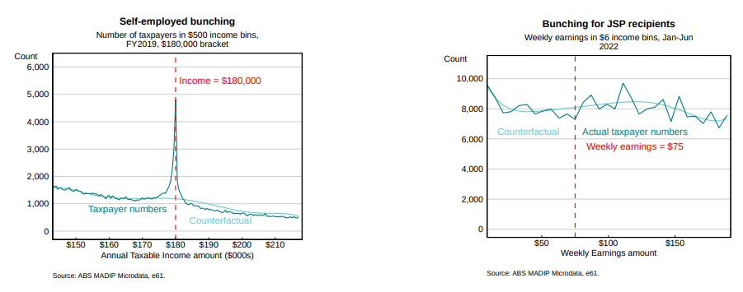
Do beneficiaries “bunch” at the abatement threshold?
No bunching – implies no intensive margin response to EMTR rise from 0% to 50%.
Similar results using DOMINO and other periods.
Similar lack of bunching found overseas.
Potential role of mutual obligations: Negative EMTR if benefit receipt relies on taking up a job.
“Extensive” participation margin is missing!

Slide 22
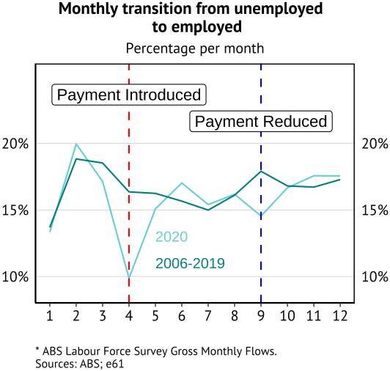
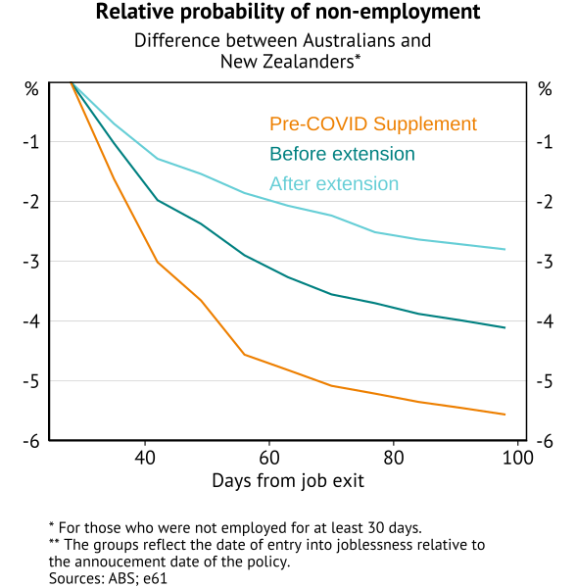
Extensive Margin: COVID Benefit Changes (early stage work)
Aim for release early-2025
Did the COVID supplement reduce labour market search/labour supply?
Borland (2020) – no appreciable difference in job-finding rates after benefit increase (ex March 2020)
What about announcement effects using high frequency (STP) data?

Slide 23
Conclusion

Slide 24
Key lessons
General findings for Australia: Expenditure declines persistently – by about 10% - following the experience of job loss.
Other lessons
Elevated job loss expectations explain part of the decline.
Voluntarily displaced individuals, and individuals who don’t take up benefits, experience smaller declines.
Work related expenses appear to explain most of the initial decline in expenditure.
Early labour supply work
Limited intensive margin responses to benefit abatement (mirroring overseas results).
Some evidence of changes in speed of reemployment (extensive margin).
Match quality and the role of mutual obligations future areas of interest.

Slide 25
APPENDIX

Slide 26
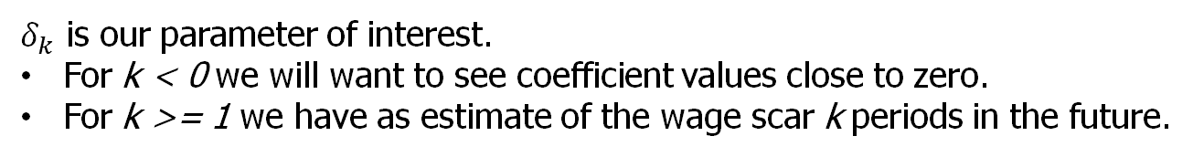
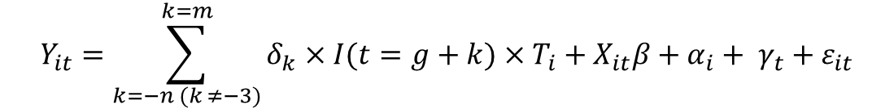
Event study approach
The base event studies (unless a TWFE approach is listed) use a Sun and Abraham (2020) interaction-weighted event study approach.
Rewrite below as it is based on individual gTTEs, but for this we can just talk about the interaction-based estimation and use of never treated individuals as controls.
$$Y_{it}=\sum_{k=−n (k ≠−3)}^{k=m}{δ_{k}×I(t=g+k)}×T_{i}+X_{it}β+α_{i}+ γ_{t}+ε_{it}$$
Here an individual's wage income in a given year is a function of time varying observable characteristics, time invariant characteristics, calendar time effects, and an idiosyncratic error term.
$δ_{k}$ is our parameter of interest.
For k < 0 we will want to see coefficient values close to zero.
For k >= 1 we have as estimate of the wage scar k periods in the future.

Slide 27
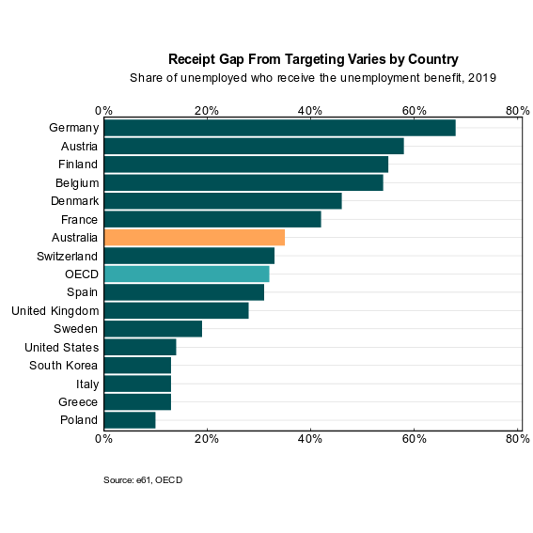
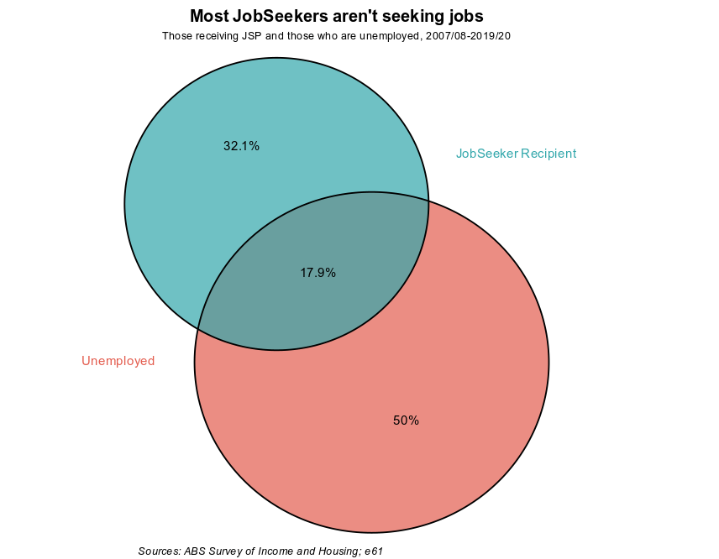
Appendix K: Result comparison across international studies

Slide 28
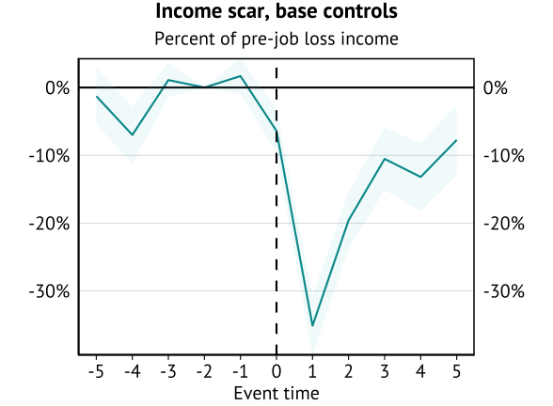
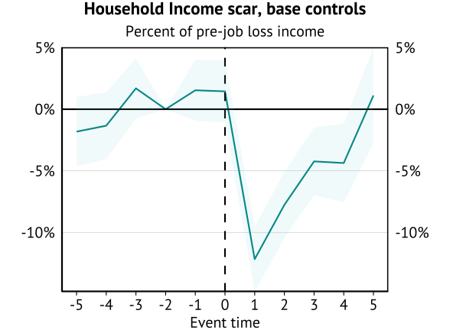
Income scarring from job loss for non-benefit recipient
Individual wages and household incomes drop persistently following job loss.
Staggered Event Study – non-benefit recipients

